Slide 1
Statistics for Engineers
Samet Yıldırım

Slide 2
Content
Data Description And Analysis | 3
Table of words | 4
Normalitiy test | 5 -- 8

Slide 3
Data Description And Analysis
 | Sales by avokado in LA(LOS ANGLES)
 | 2015 – 2018 in april avokado sales amount
 | 340 observation and 10 variable
 | 1 catogarical variable and 9 numarical variable
 | Date,AveragePrice,TotalAvocados,Small,Extra Large Large,Total Bags,Small Bags,Large Bags,XLarge Bags,type
For more info: www.Kaggle.com

Slide 4
Table Of Words
Date
AveragePrice
TotalAvocados
Variable time, year
month day
Avarage price in Los Angles
in this day
Total number of
avokado sales
Small
Extra
Large
Large
Total number of avokado sales for small
Total number of avokado sales for extra large
Total number of avokado
sales for large
Total
Bags
Small
Bags
Large
Bags
Total number of avokado
packets in sales
Total number of avokado
packets in sales for small
Total number of avokado packets in sales for large
Xlarge
Bags
Type
Total number of avokado packets in sales for XLarge
Organic or conventional

Slide 5
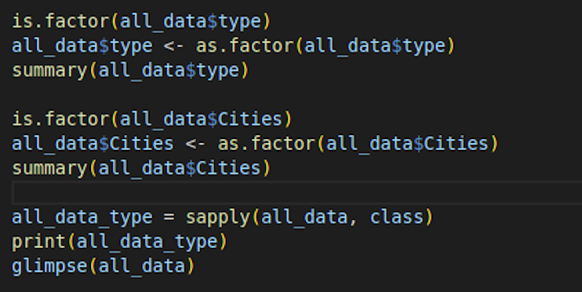
Data Description And Analysis
Why we convert factor ?
The factor data type enables accurate representation of categorical data and offers several advantages in the data analysis process. By using factors, it becomes possible to group data, examine categorical relationships, and make the dataset more comprehensible. Therefore, factors are a significant tool in data analysis and modeling processes within the R programming language.

Slide 6
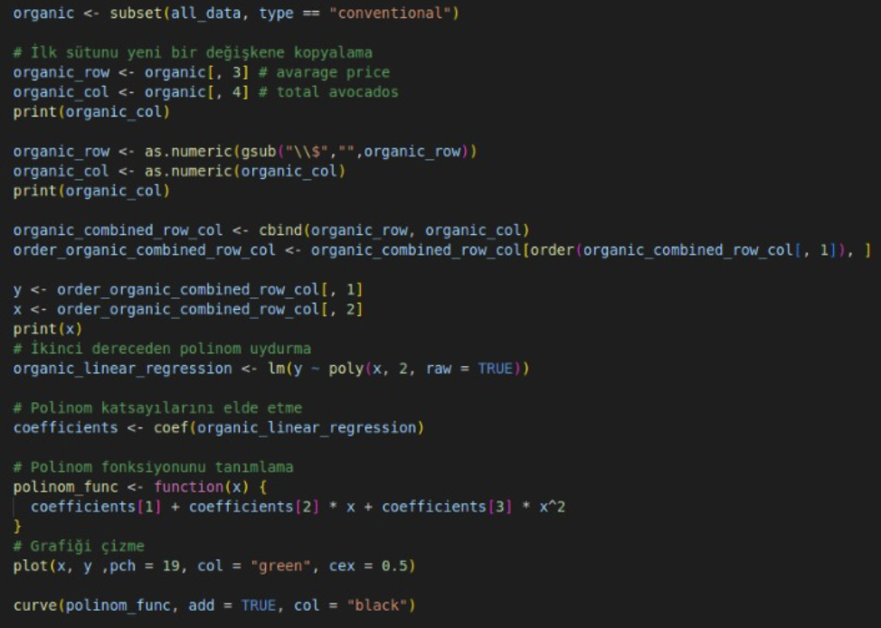
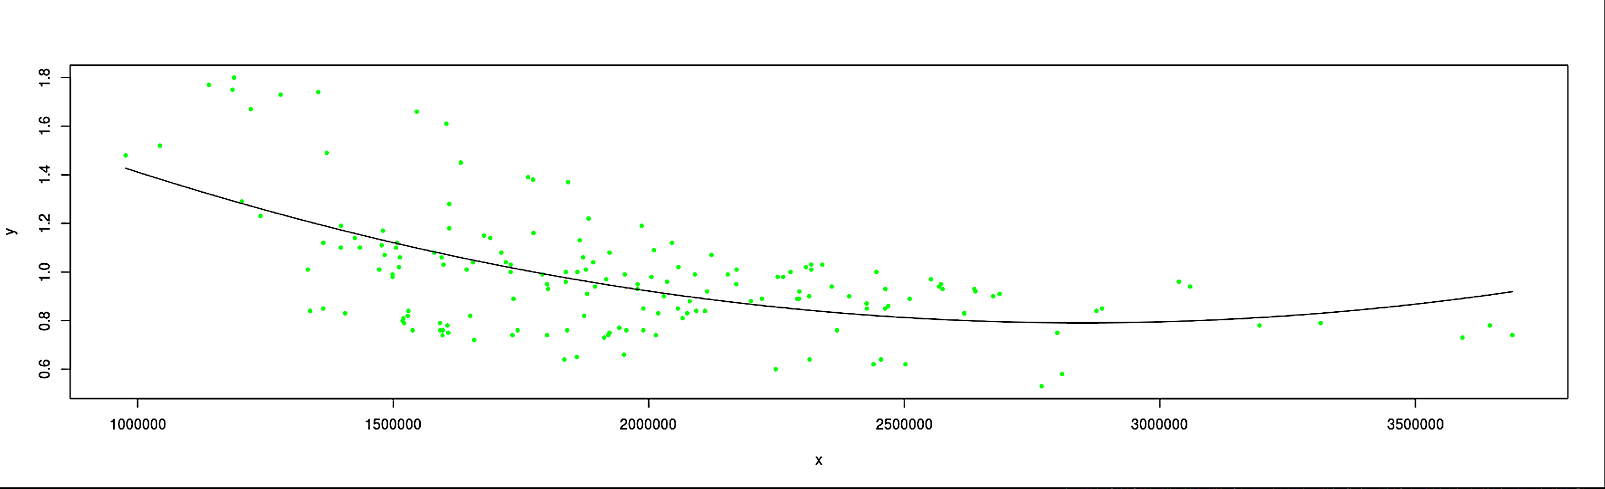
Data description and analysis
Average price chart of conventional avocados
Middle line is Linear regrasion line

Slide 7
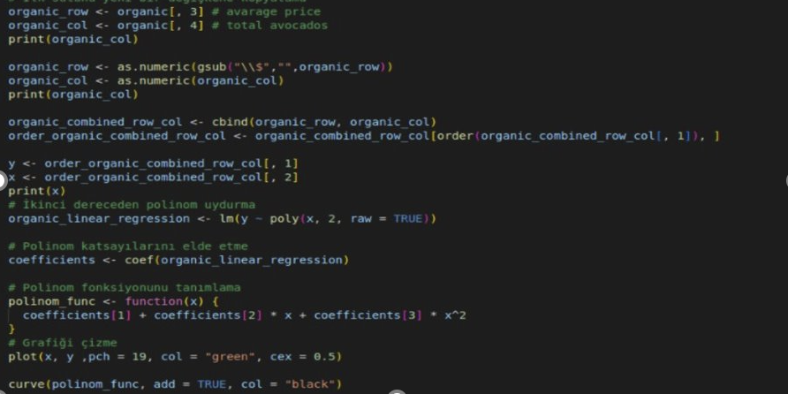
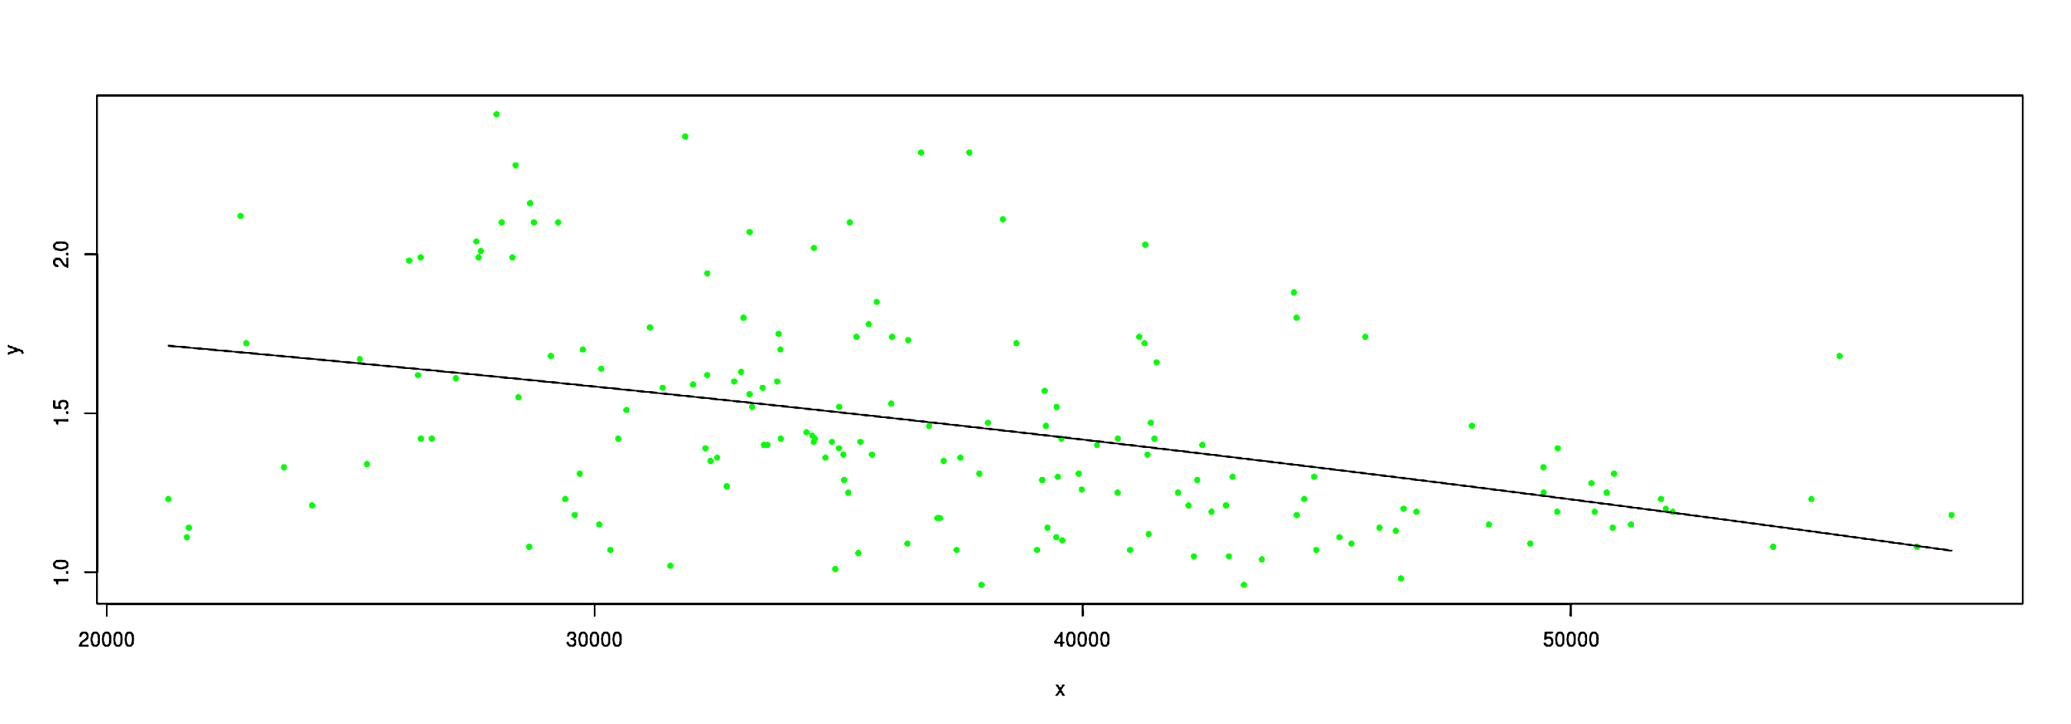
Data description and analysis
Average price chart of conventional avocados
Middle line is Linear regrasion line

Slide 8
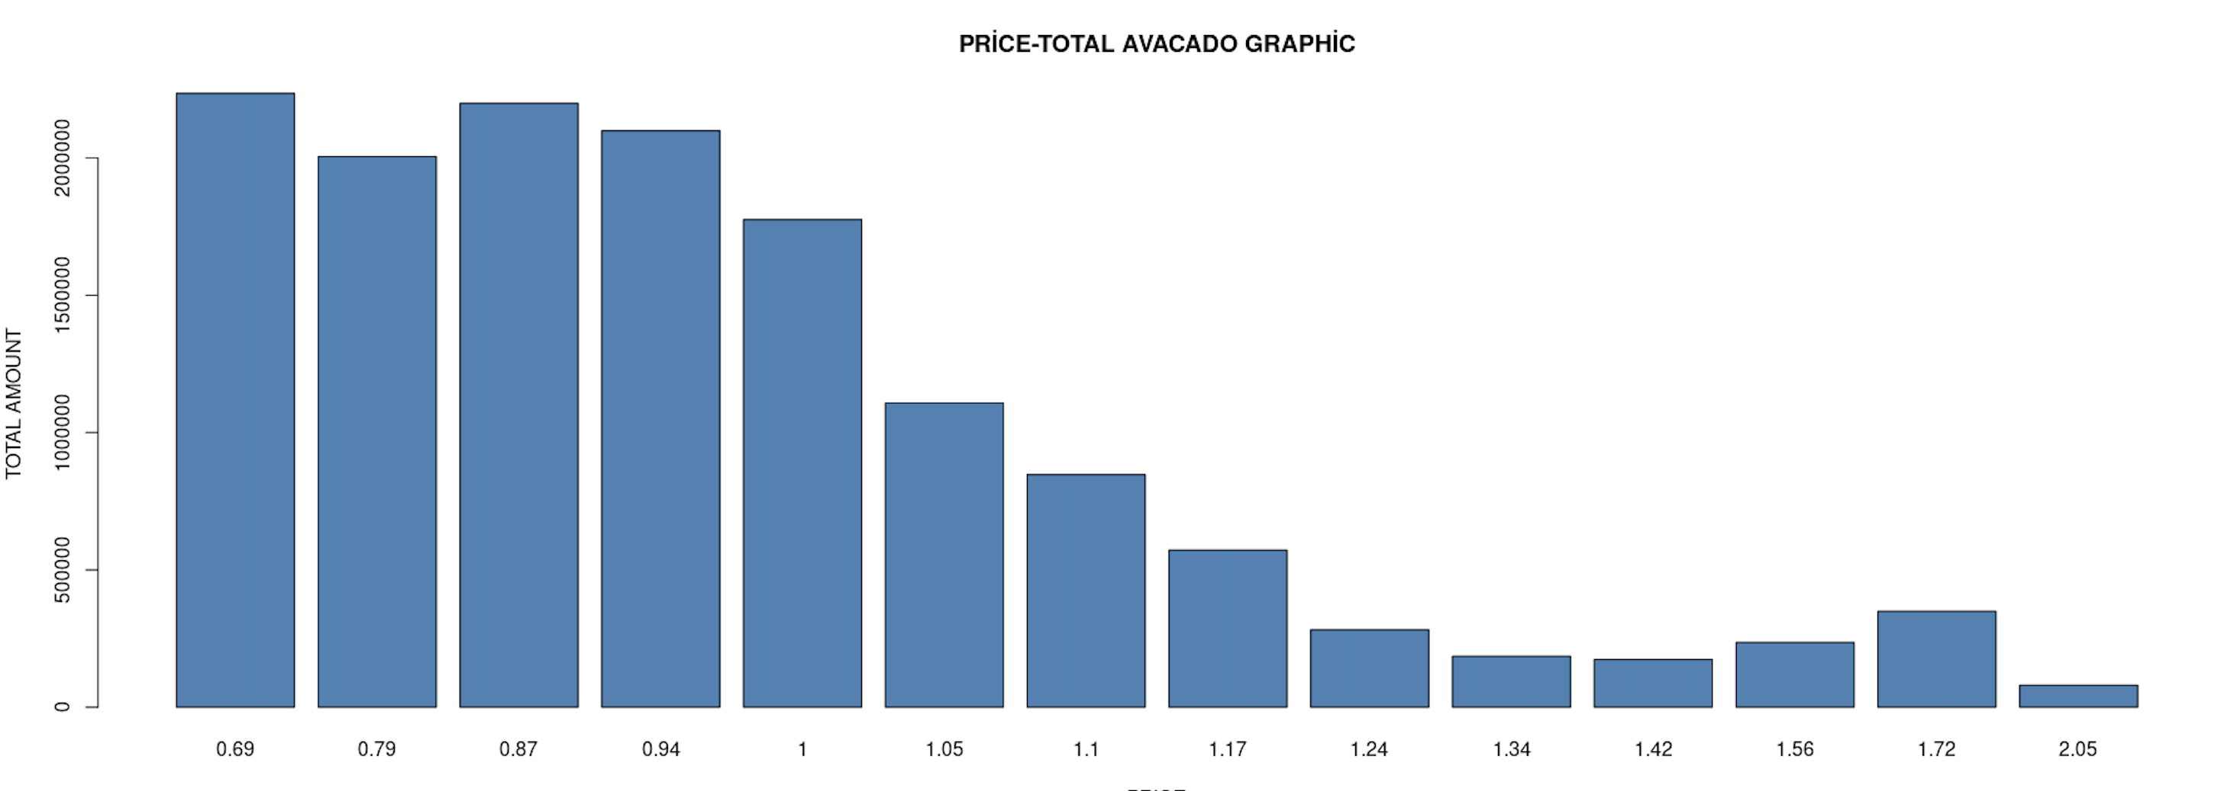
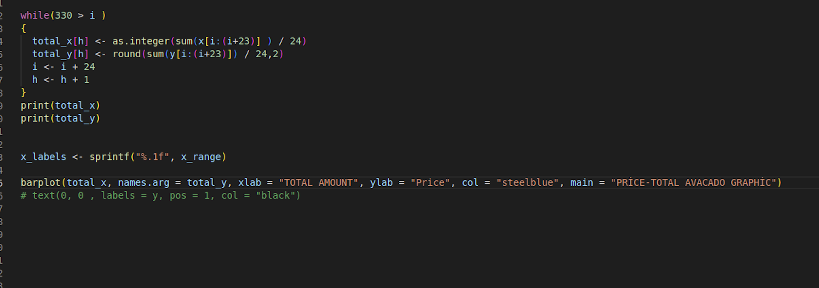
Data Description And Analysis
- We divided our data number, which is a total of 340, by 24 and got 14 groups.
- According to the table, as the price of avocado increases, the number of products sold decreases.

Slide 9
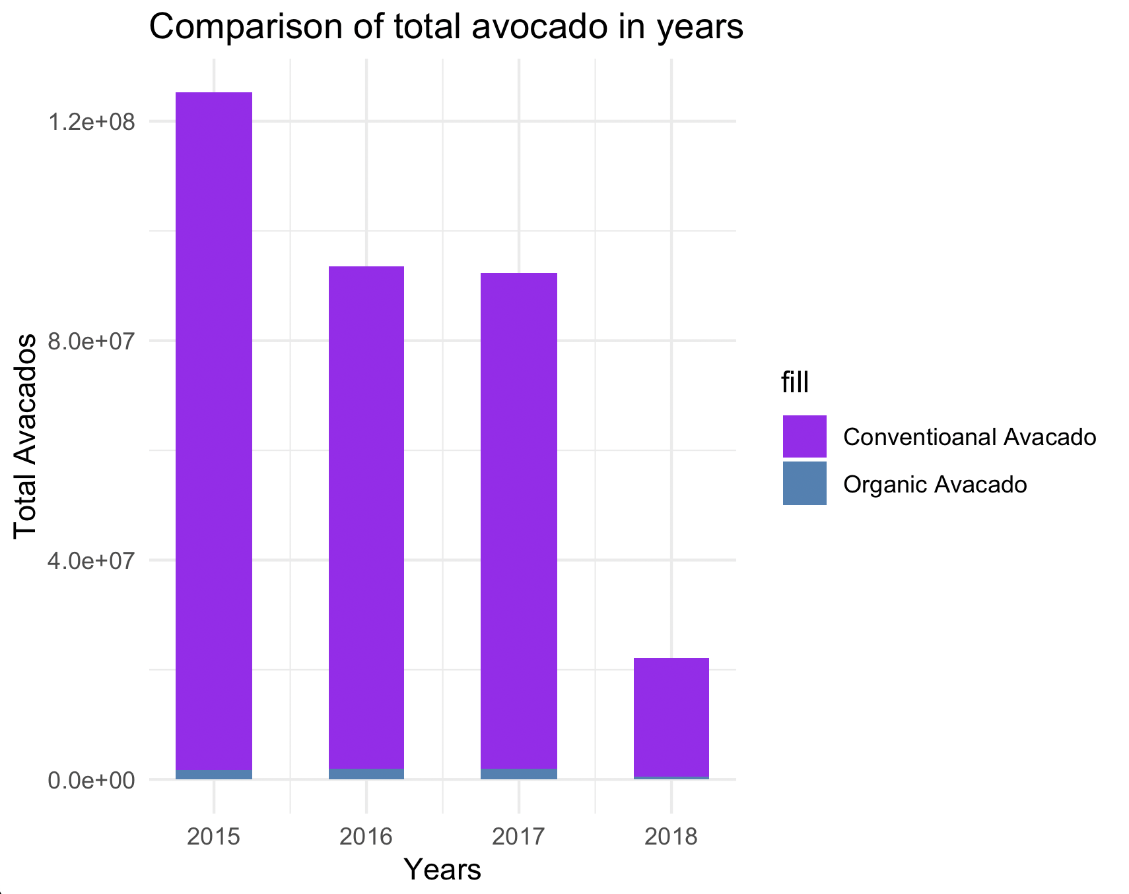
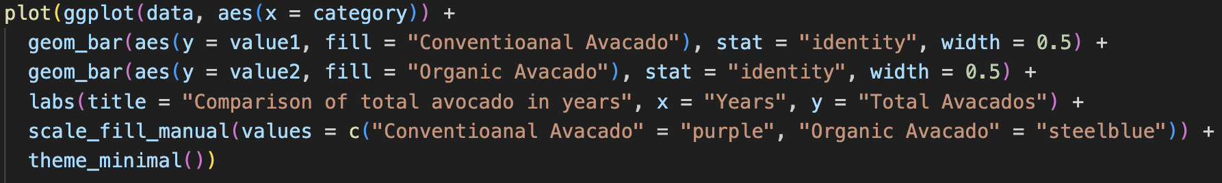
Data Description And Analysis
- A comparison between organic and conventional avocados has been made by years.
- According to the table, it is clearly evident that organic avocados are not preferred.

Slide 10
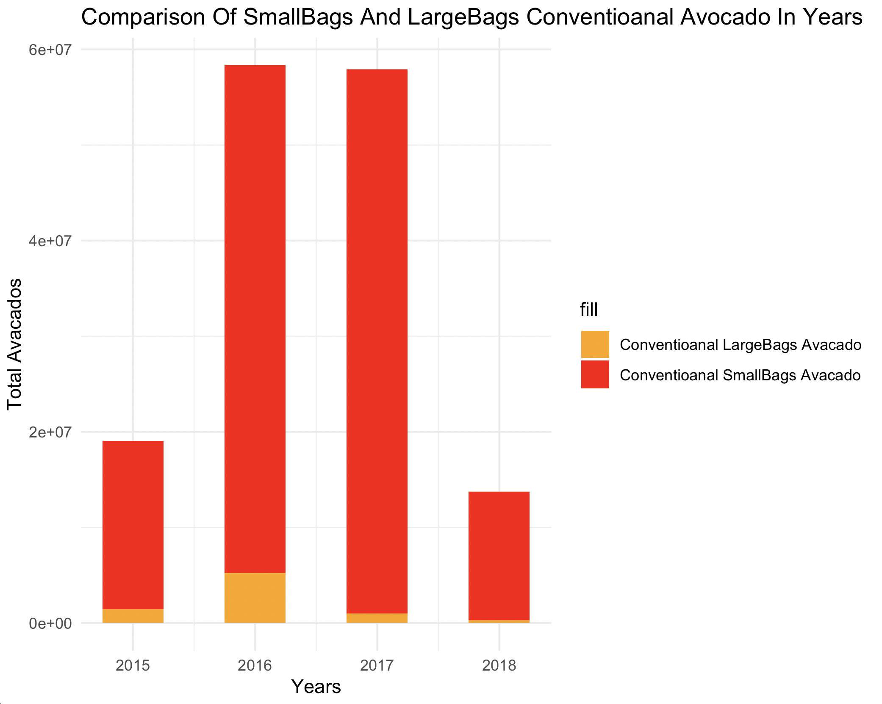
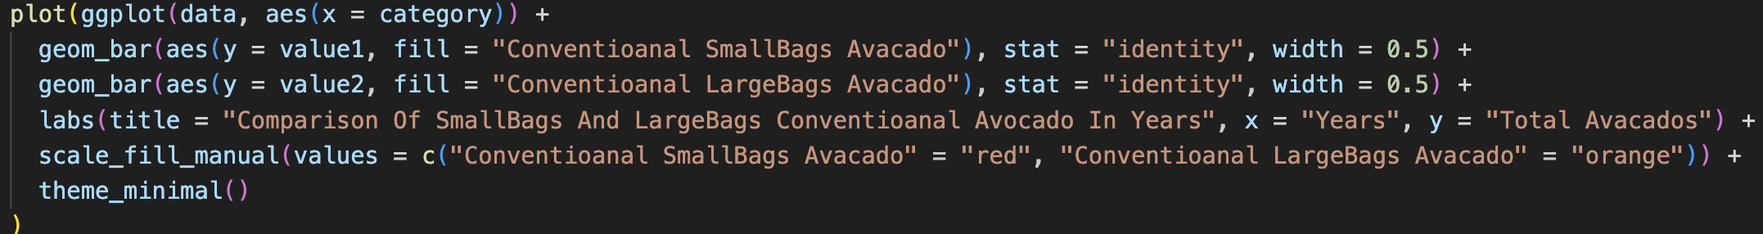
Data Description And Analysis
- Comparison of small and large pack avocado sales by years for conventional avocados.
- According to the table, small packages of conventional avocados have been sold more than large packages. Especially in the year 2017, the difference between small and large packages is significant.

Slide 11
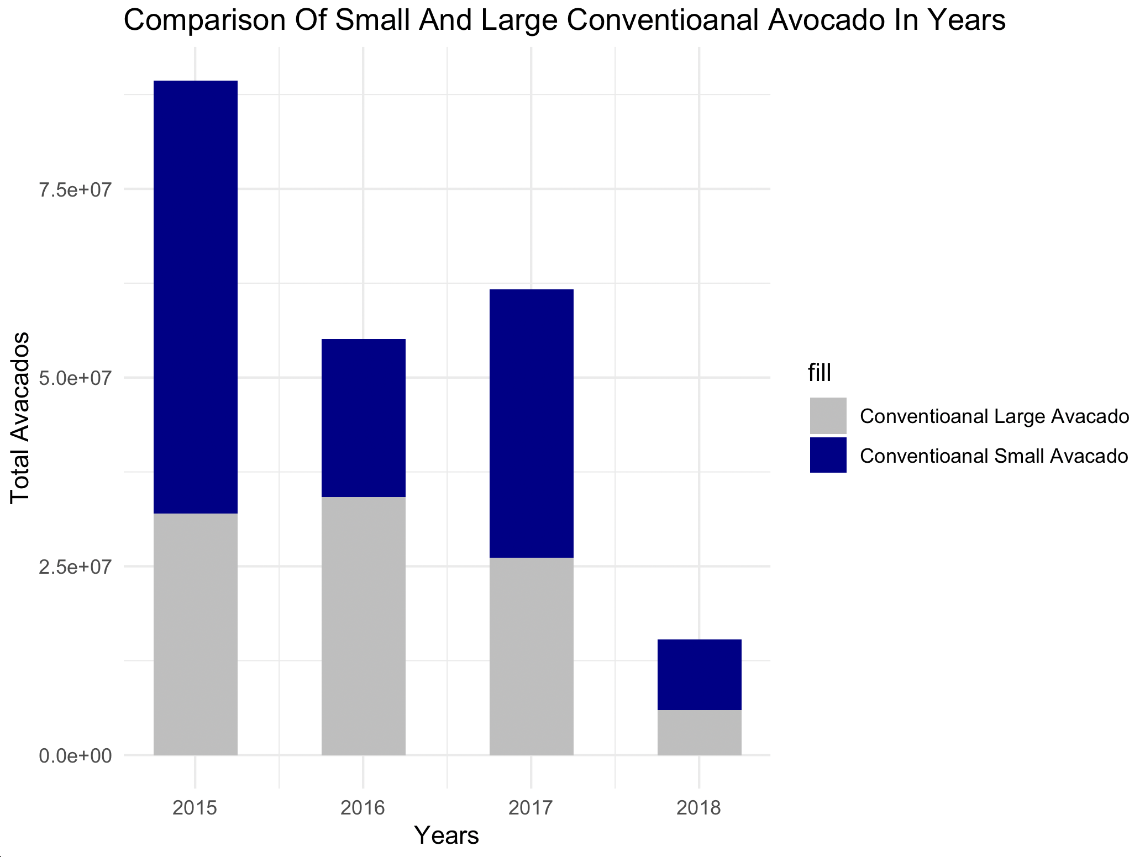
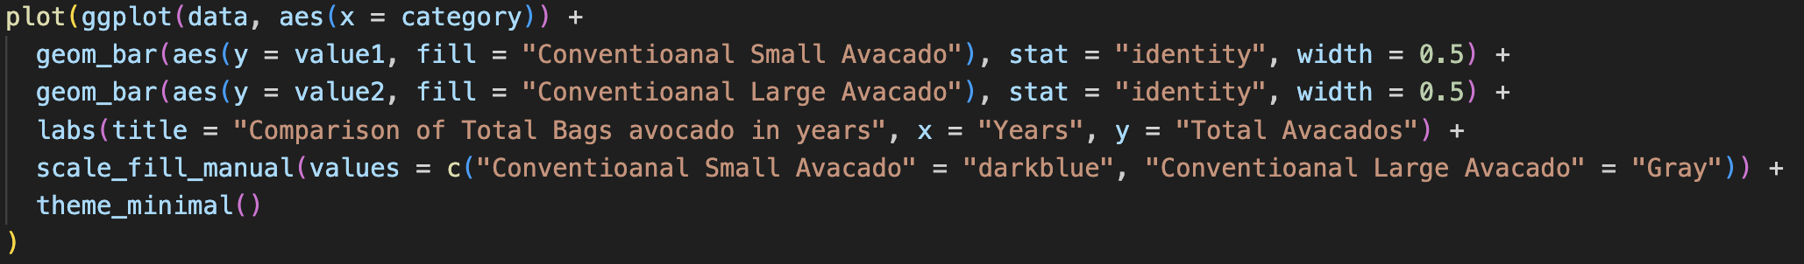
Data Description And Analysis
- This table presents the distributions of small and large conventional avocados by years.
- The least total sales of both large and small conventional avocados were recorded in 2018.

Slide 12
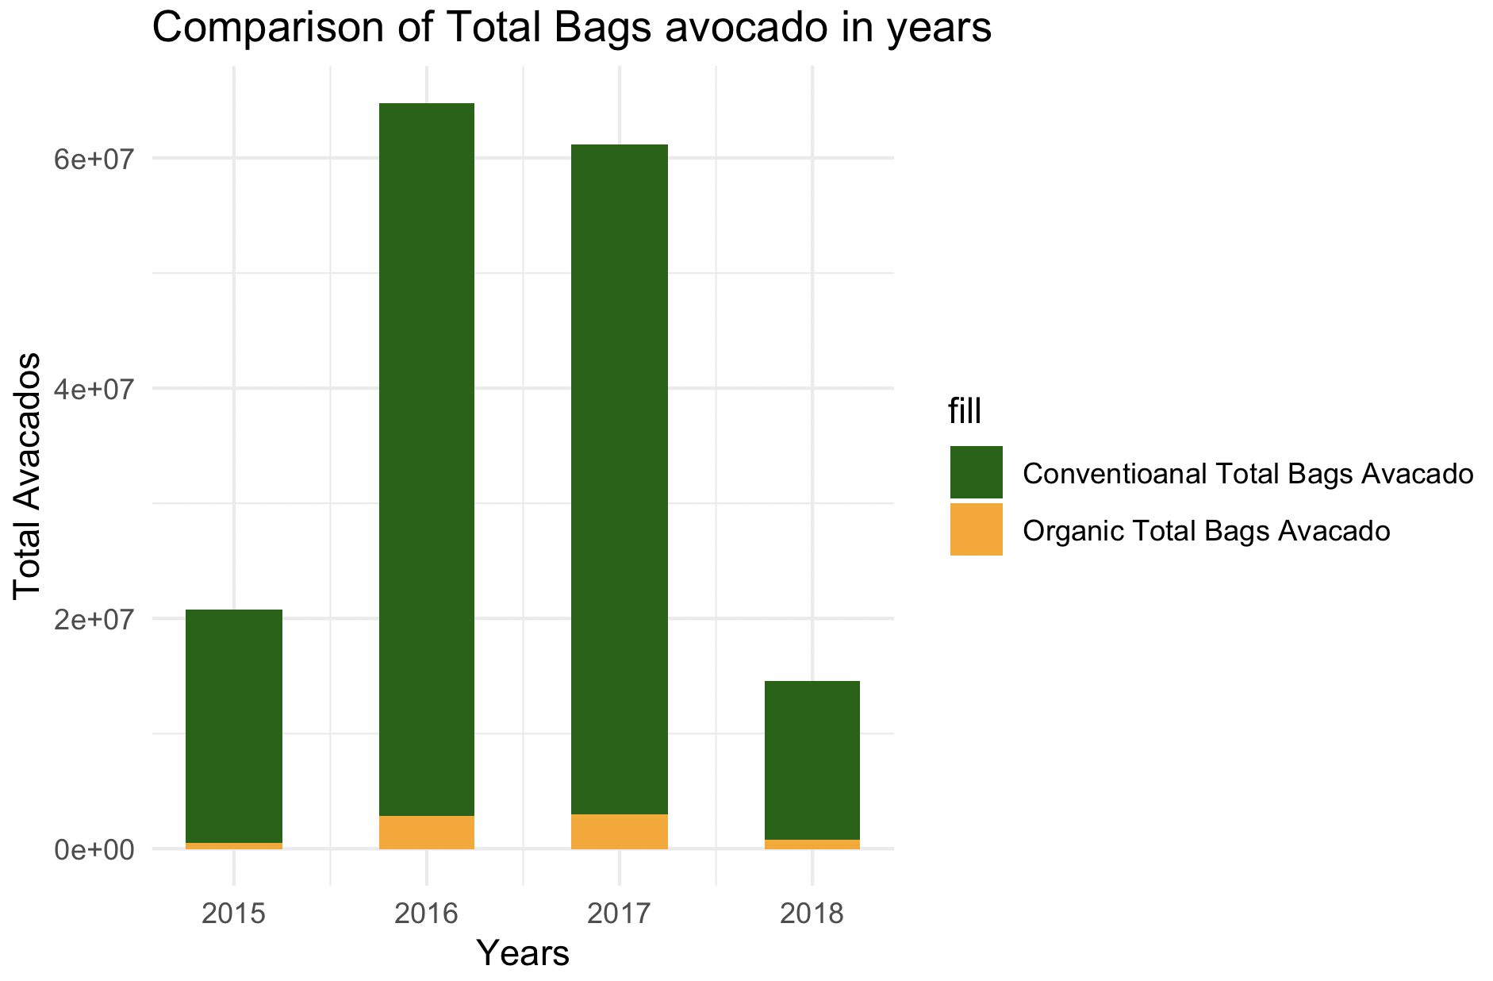
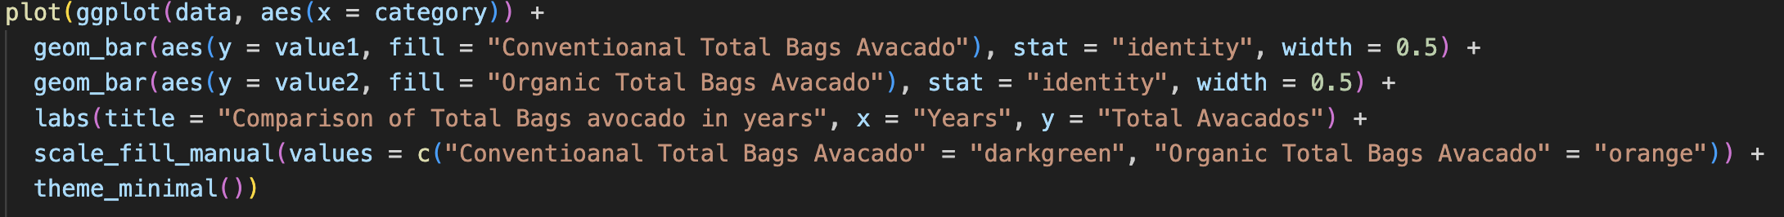
Data Description And Analysis
- A bar graph of the total bags sold for organic and conventional avocados by years is provided.
- It can be observed that there was a significant amount of both conventional and organic avocados sold in 2016 and 2017.

Slide 13
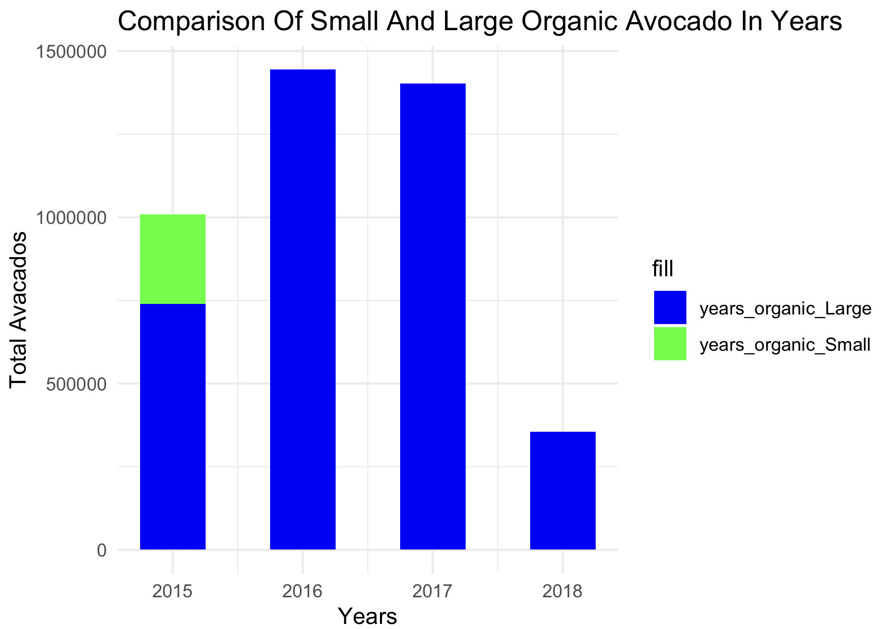
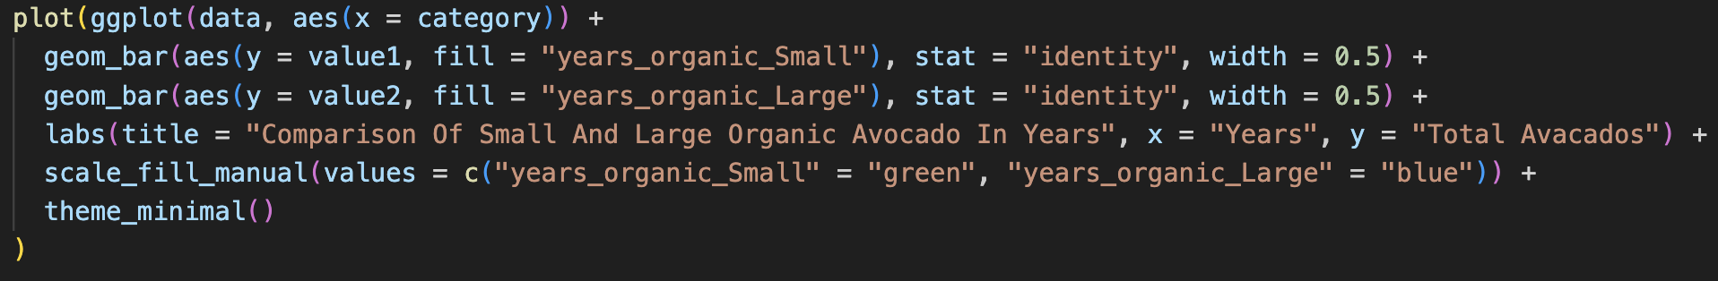
Data Description And Analysis
- A sales graph of small and large sizes of organic avocados by year is provided.
- It can be observed that the highest preference for small organic avocados was recorded in the year 2015.

Slide 14
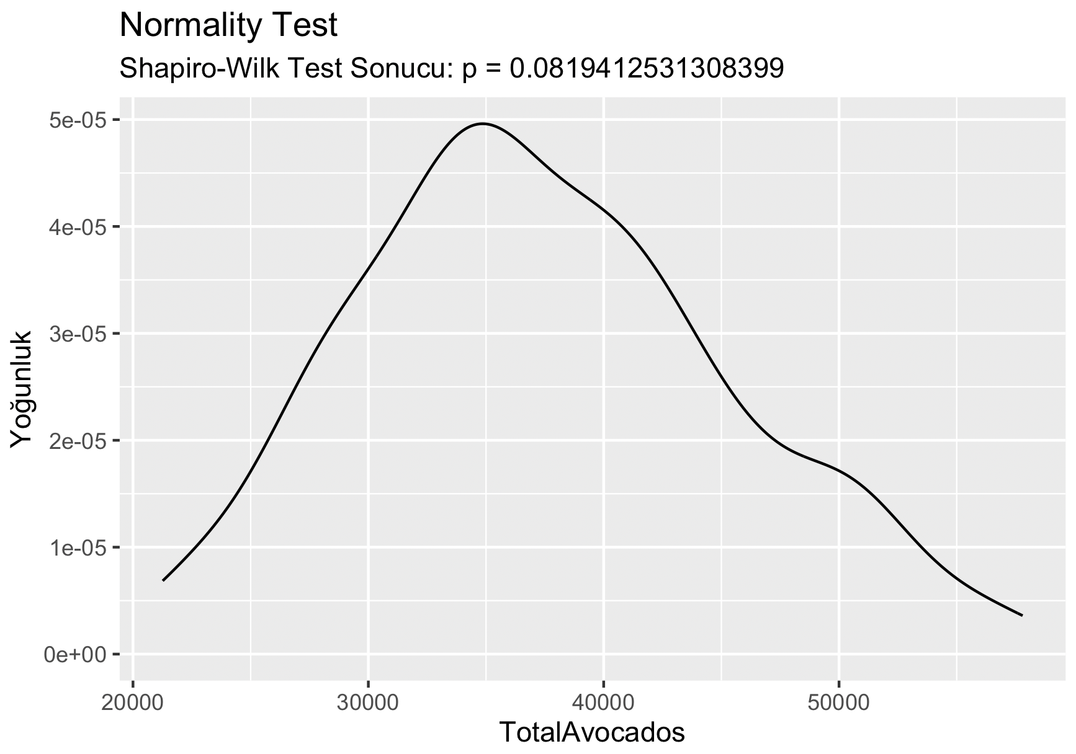
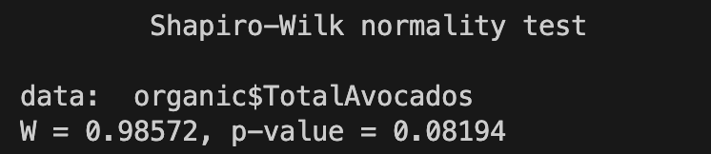
Normality Test
- The density curve represents a visual representation of the normal distribution plot of the wage distribution for total avocados.
- To interpret the results, we compare the p-value to a predetermined significance level (usually 0.05). If the p-value is less than the significance level, we reject the null hypothesis, indicating that the data does not follow a normal distribution.
In this case, the p-value of 0.08194 is greater than the commonly used significance level of 0.05. Therefore, we fail to reject the null hypothesis at the 0.05 significance level.

Slide 15
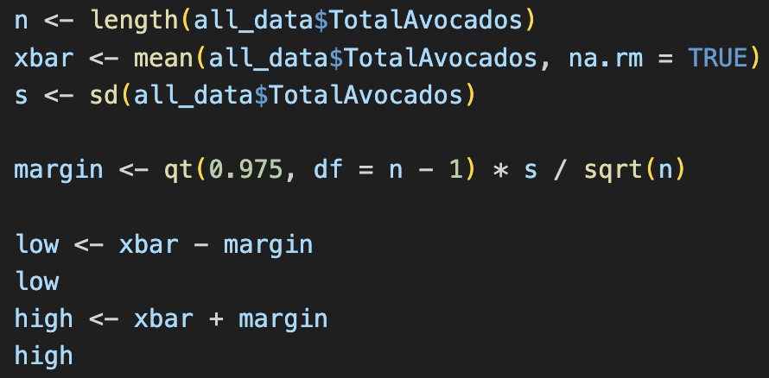
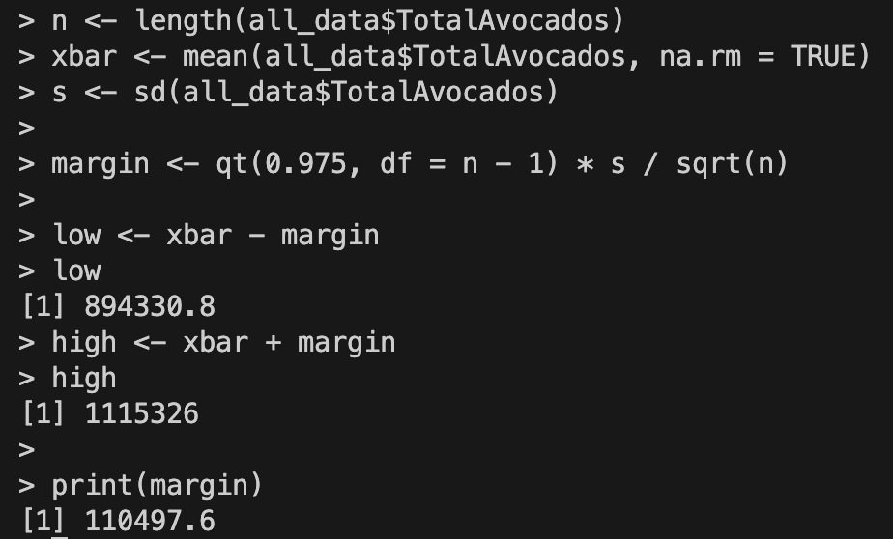
Point Estimation & Confidence Interval
1. The length of the dataset "all_data$totalavocados" is stored in the variable "n".
2. The mean of the dataset, excluding any missing values, is calculated and stored in the variable "xbar".
3. The standard deviation of the dataset is calculated and stored in the variable "s".
4. The margin of error is calculated using the t-distribution. The value "qt(0.975, df = n - 1)" represents the critical value for a 95% confidence interval (with a two-tailed test) based on the t-distribution. The result is stored in the variable "margin".
5. The lower bound of the confidence interval is calculated by subtracting the margin from the sample mean (xbar). The result is stored in the variable "low".
6. The upper bound of the confidence interval is calculated by adding the margin to the sample mean (xbar). The result is stored in the variable "high".
7. The value of the margin is printed, resulting in 110497.6.
The calculated confidence interval (with a 95% confidence level) for the mean of the "all_data$totalavocados" dataset is approximately 894,330.8 to 1,115,326. This means that we can be 95% confident that the true population mean falls within this range.

Slide 16
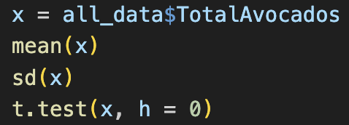
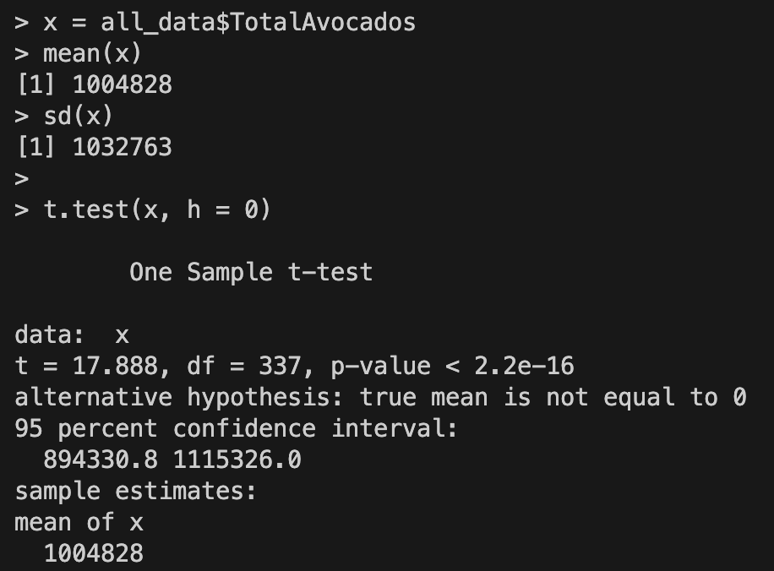
Hypothesis
The t-test was used to test whether the mean value of the data in the TotalAvocados column is significantly different from zero. The phrase "One Sample t-test" refers to the t-test conducted on a single sample set. The "t" value represents the t-test statistic, which in this case is 17.888. The "df" value indicates the degrees of freedom for the t-test, which is 337 in this case. The "p-value" value represents the p-value. It is stated that the p-value is < 2.2e-16, indicating a very low p-value. This implies that the mean value of the data in the TotalAvocados column is significantly different from zero. The phrase "alternative hypothesis" refers to stating the alternative hypothesis.
In this case, the alternative hypothesis is defined as "true mean is not equal to 0." The phrase "95 percent confidence interval" refers to the interval that allows us to estimate that the mean value of the data in the TotalAvocados column is between 894,330.8 and 1,115,326.0 with 95% confidence. The phrase "sample estimates" represents the sample estimate, which in this case is calculated as the sample mean of the data in the TotalAvocados column, which is 1,004,828. Therefore, based on this t-test result, we can conclude that the mean value of the data in the TotalAvocados column is significantly different from zero. This information provides insights into the population mean of the TotalAvocados data, showing that it is different from zero.

Slide 17
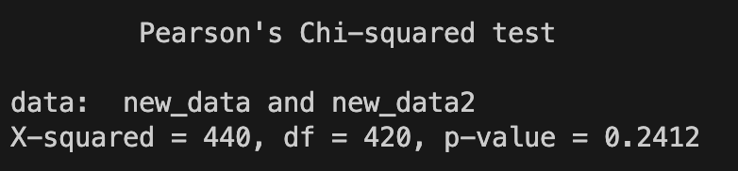
Goodness of Fit Tests
Null hypothesis (H0): There is no relationship between two variables (new_data and new_data2). Alternative hypothesis (H1): There is a relationship between the two variables. X-squared = 440, df = 420, p-value = 0.2412: The obtained p-value does not provide significant evidence to reject the null hypothesis and conclude that there is a significant relationship between the two variables. However, the warning message indicates that the chi-square approach may not be accurate. Therefore, there is some doubt about the reliability of the result. In conclusion, both tests do not support the presence of a significant relationship between the two variables. However, due to the warning message in the chi-square test, there is some doubt about the reliability of the result.

Slide 18
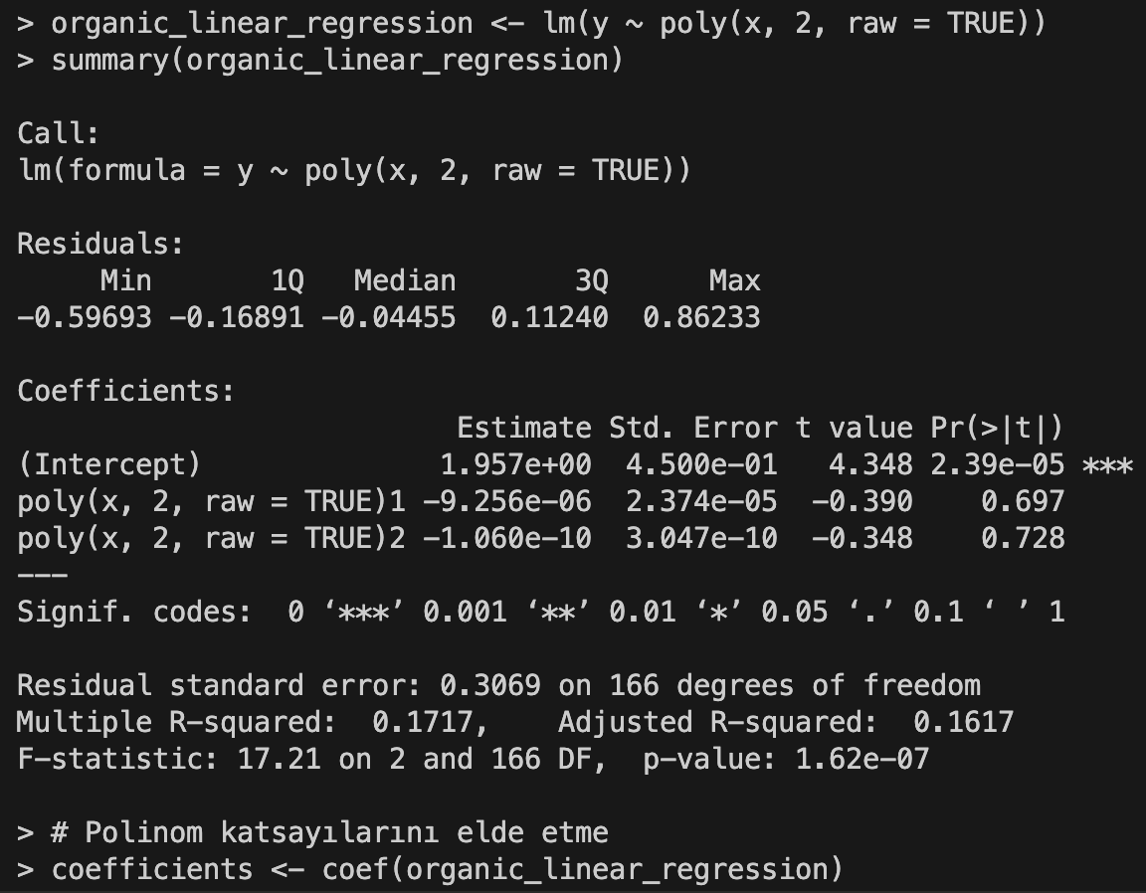
Linear Regression Model
The code is r analysis involving avocados data, focusing on the relationship between average price and the quantity of organic avocados.

Slide 19
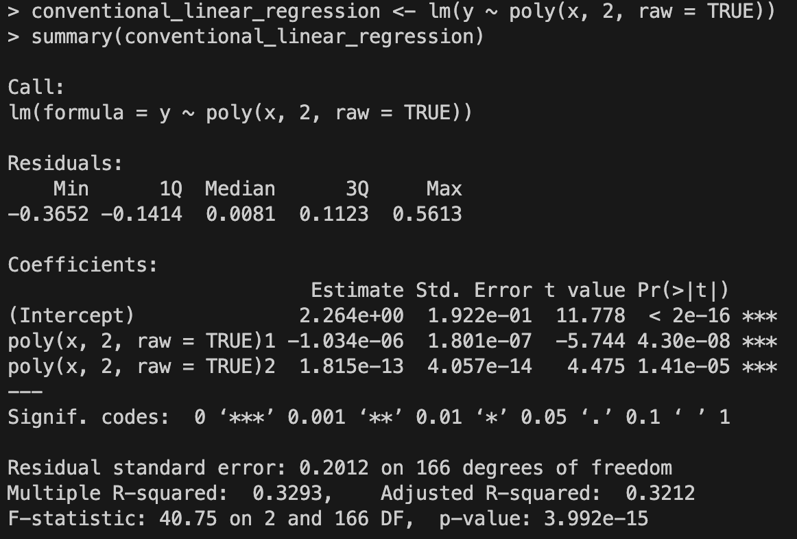
Linear Regression Model
The previous code snippet and performs a similar analysis, but this time focusing on the relationship between average price and the quantity of conventional avocados.

Slide 20
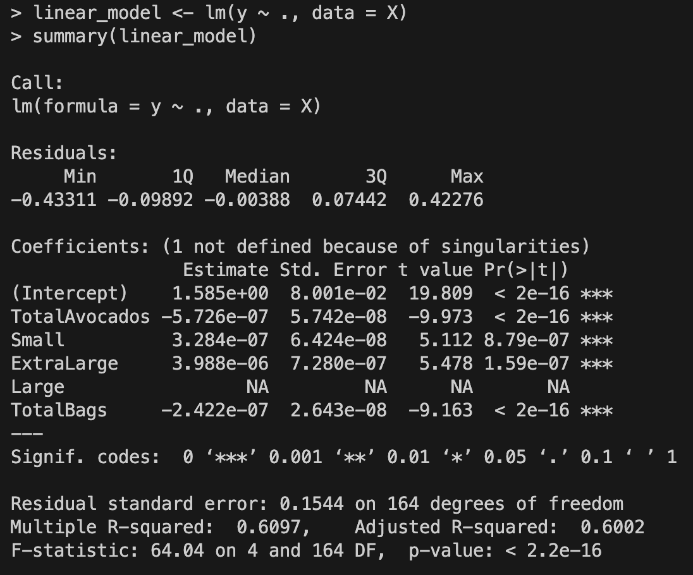
Linear Regression Model
Linear regression model is created to analyze the relationship between average price and various avocado attributes for the "conventional" type.

Slide 21
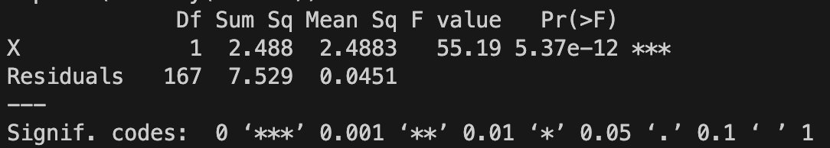
ANOVA
This output shows the results of the ANOVA analysis. The relevant output contains the following
information:
Df (Degrees of Freedom): The degrees of freedom is the amount of the independent variable in the
model.
Sum Sq (Sum of Squares): The sum of squares is the size of the total variance between the variables.
Mean Sq (Mean Square): The mean squares is the mean value of the corresponding variance (Sum of
Squares / Degrees of freedom).
F value: The F value is the analysis of variance test statistic and shows the effect of the difference
between the variables.
Pr(>F): The corresponding p-value of the F times indicates the interpretation of the test statistic. A
small p-value indicates that the difference between the variables confirms as carrying.
The *** symbol: the output indicates that the p-conservation is quite low and the difference
between the variables affects. In this case, it contains that variable X has an effect on Average Price.

Slide 22
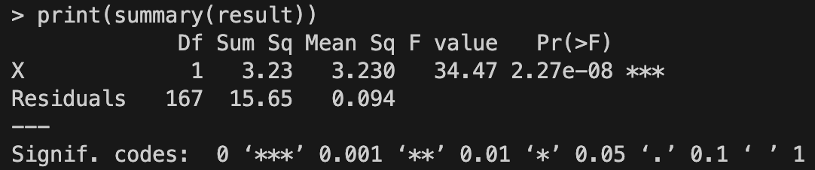
ANOVA
In summary, the F-value and the p-value are used to determine the objective changes as constraints between the variables as a result of the ANOVA analysis. This has an effect on the output where the variable X has an effect on the Average Price.

Slide 23
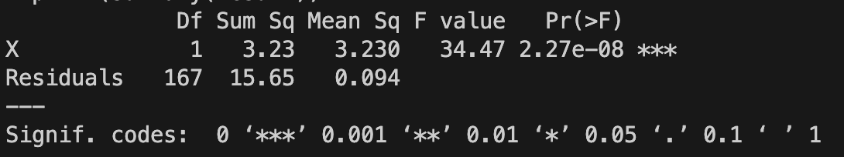
ANOVA
- 3 One-way ANOVAs were applied
- Observed degrees of freedom, sum of squares,
mean of squares, F value and Pr (>F) are as above

Slide 24
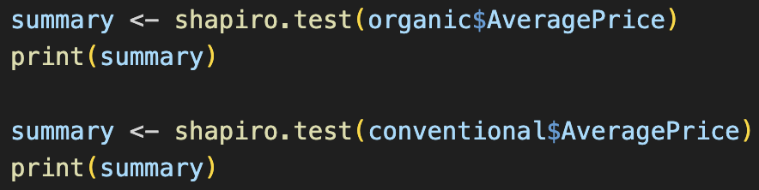
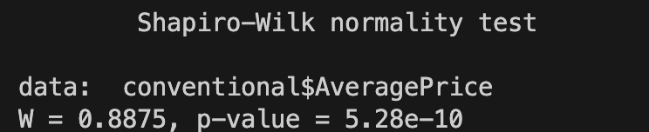
Non-parametric Tests
The shapiro.test() function is used to test whether a data set is normally distributed. This test evaluates whether the data converges to the normal distribution.
The information in the output means at the end:
data: Name or description of the dataset being tested
W: Shapiro-Wilk test stat value
p-value: p-value calculated from hypothesis testing
In this output, the values obtained as a result of the Shapiro-Wilk normality test for the organic $AveragePrice dataset are taken.
Shapiro-Wilk test istatistiği (W), verinin normal dağılıma ne kadar yakın olduğunu gösterir. Değer 1'e yaklaştıkça, verinin normal dağılımına daha yakınlığı belirlenir.
Bu çıktıya göre, organic$AveragePrice veri setinin normal dağılıma uygun olduğunu gösteren bir p değeri elde edilmiştir (p-değeri = 1.265e-07). Bu durumda, veri setinin normal dağılıma uygun olduğu bulunuyor.

Slide 25
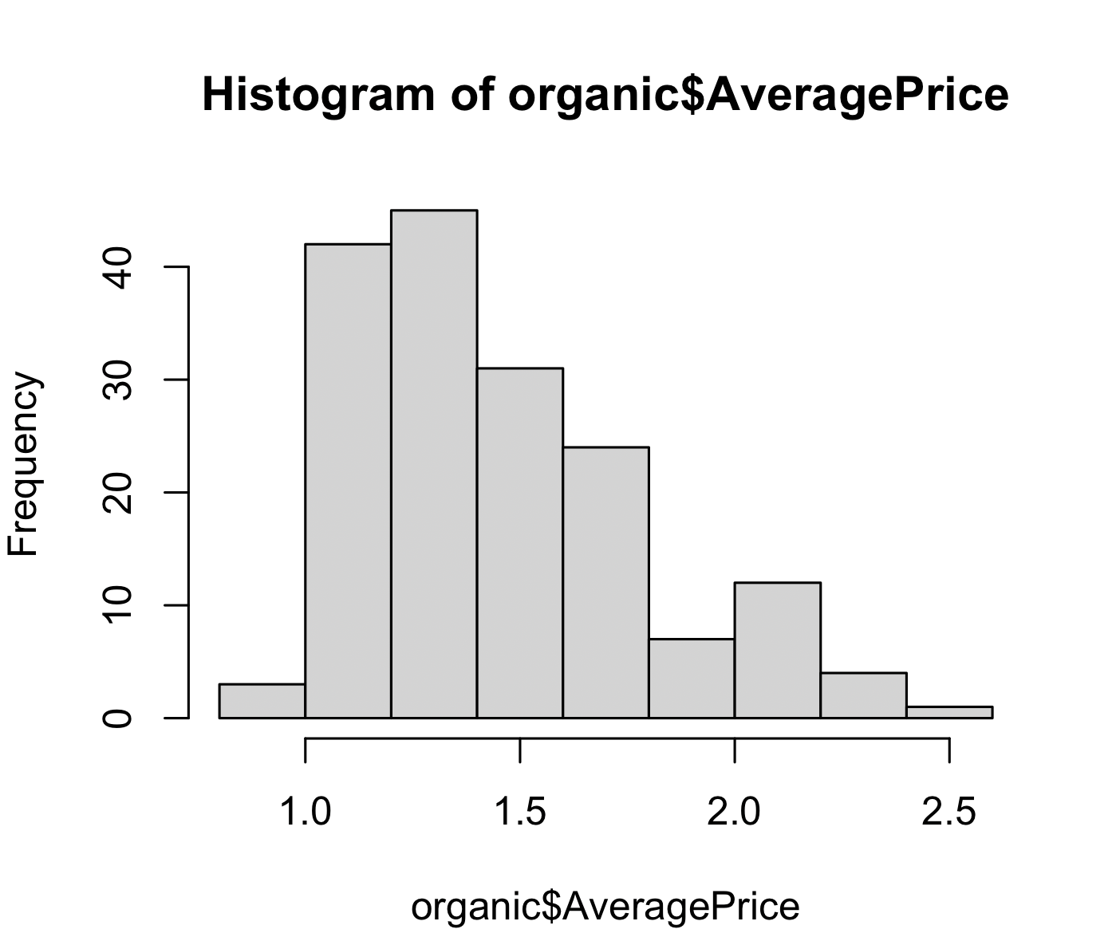
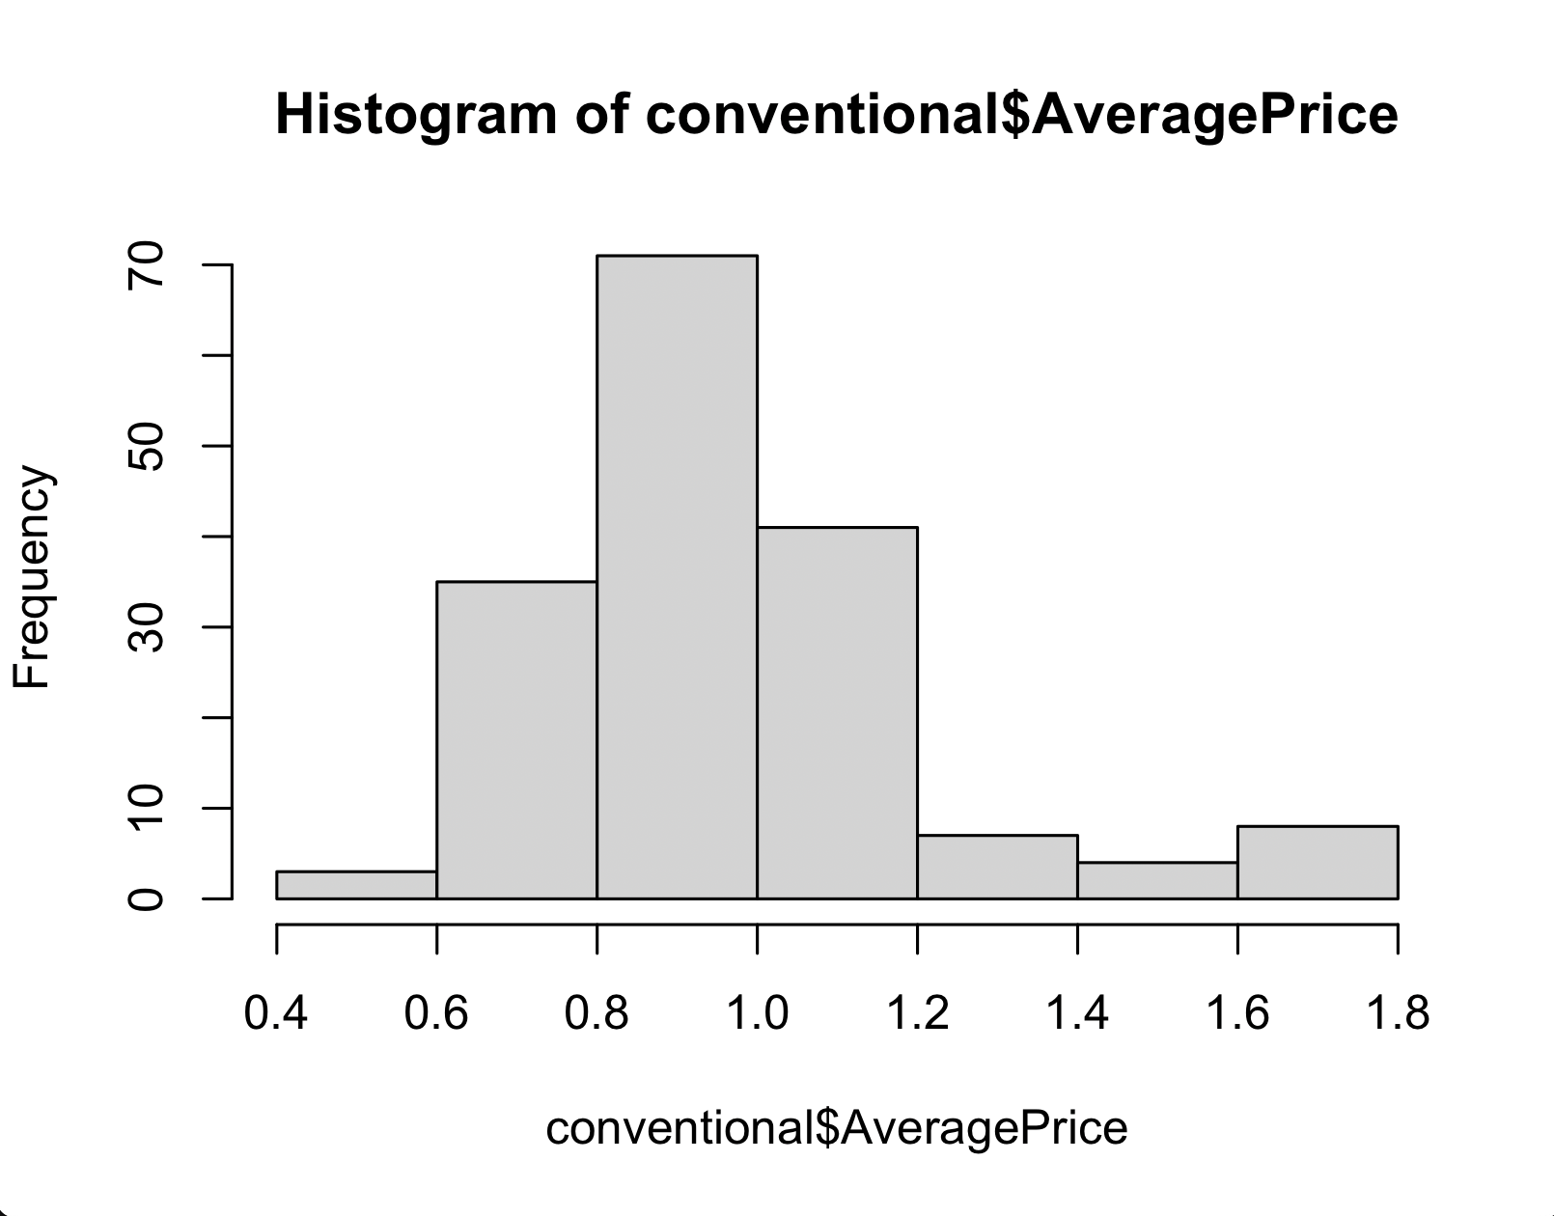
Non-parametric Tests
we visualized the histogram to see the conventional variable follows a normal distribution
Also, we visualized the histogram to see the organic variable follows a normal distribution

Slide 26
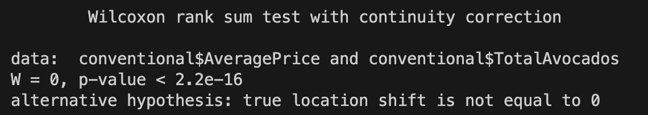
Non-parametric Tests
This output shows the results of a test called the "Wilcoxon rank sum test with continuity correction". This test is used to determine if there is a difference between two independent groups as hosted. The test is based on ordering the data in groups.
Based on this output, it is concluded that there is a statistically significant difference between the conventional$AveragePrice and conventional$TotalAvocados datasets. Since the p-value is very small (p-value < 2.2e-16), it is concluded that the displacement difference between the groups is not zero and is statistically significant.

Slide 27
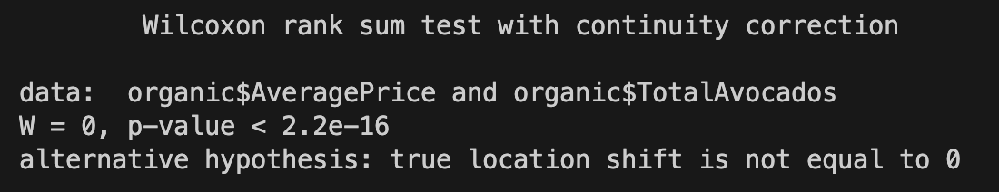
Non-parametric Tests
This output shows the results of a test called "Wilcoxon rank sum test with continuity correction". This test is used to determine whether there is a statistically significant difference between two independent groups. The test is based on ranking data in groups.
The information in the output means:
Based on this output, it is concluded that there is a statistically significant difference between the conventional$AveragePrice and conventional$TotalAvocados datasets. Since the p-value is very small (p-value < 2.2e-16), it is concluded that the displacement difference between the groups is not zero and is statistically significant.

Slide 28
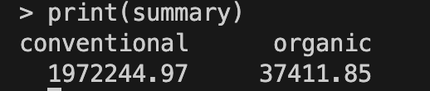
Non-parametric Tests
The tapply() function is an R function used to summarize or aggregate data by a particular factor or
group. It takes two basic parameters: X and INDEX.
X: The data vector or matrix you want to sum or sum.
INDEX: It is the factor or vector of factors that enables the data to be grouped. These factors indicate which groups the data belong to.

Slide 29
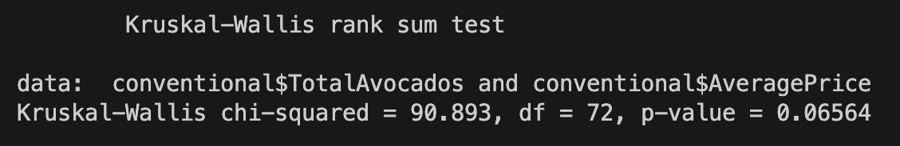
Non-parametric Tests
The Kruskal-Wallis test is a statistical test used to evaluate the relationship between a categorical independent variable (factor) and a continuous dependent variable. This test is used to determine whether there is a statistically significant difference between the median values of the groups.
The hypotheses of the test are:
Null hypothesis (H0): There is no difference between the median values of the groups.
Alternative hypothesis (H1): There is a difference between the median values of the groups.
The Kruskal-Wallis test assumes that the groups are independent samples, respectively, and that the distribution of each group is continuous and similar.
The Kruskal-Wallis test seen in this printout evaluates whether there is a statistically significant difference in median values between the groups between the conventional$TotalAvocados and conventional$AveragePrice variants.

Slide 30
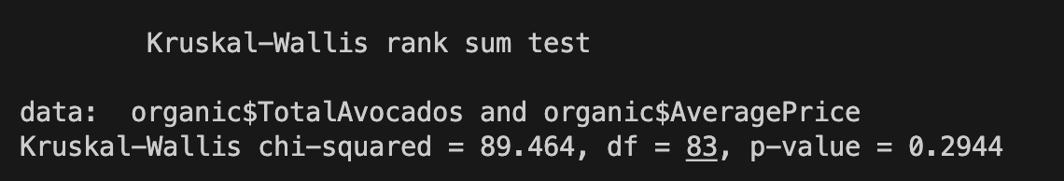
Non-parametric Tests
Bu çıktıda görülen Kruskal-Wallis testi, organic$TotalAvocados ve organic$AveragePrice değişkenleri arasındaki gruplar arasında medyan değerler açısından istatistiksel olarak anlamlı bir farklılık olup olmadığını değerlendirmektedir.
Bu çıktıda, p-value değeri 0.2944 olarak verilmiştir. Genellikle kabul edilen anlamlılık düzeyi (α) 0.05'tir. Eğer p-value değeri bu anlamlılık düzeyinden küçükse (p-value < α), gruplar arasında anlamlı bir fark olduğu sonucuna varılır. Ancak bu durumda p-value değeri 0.2944 olduğu için, belirli bir anlamlılık düzeyinde (α = 0.05) gruplar arasında anlamlı bir fark olduğu iddia edilemez. Bu nedenle, organic$TotalAvocados ve organic$AveragePrice arasındaki gruplar arasında medyan değerler açısından anlamlı bir fark olmadığı sonucuna varılabilir.

Slide 31
References
1 | www.kaggle.com
2 | Robert S. Witte, John S. Witte ve Susan L. Witte

Slide 32
Thank You For Listening
Samet Yıldırım
Statistics for Engineers

